Slide 1

31st May Update
Overview
Individual Anatomy Results
Moving Forward

Slide 2
Presentation Flow
Recap of concepts
Standard Deviation
Mean Absolute Error (MAE), R-squared (R2)
Accuracy, Precision, Sensitivity and Specificity
Correlation
LOOCV (leave one out cross validation)
Hemoglobin Distribution
Feature List
List of models regression models compared
Setup
Eye
Nail
Palm
Tongue
Combined Anatomy

Slide 3
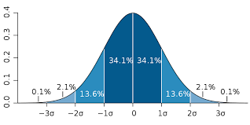

Mean Absolute Error (MAE)
R-squared (R2)
MAE is the average value of all the absolute errors i.e. the magnitude of difference between the predicted Hb value and the true Hb value.
R-squared represents the goodness of fit of a regression model.
R-square equals 1 implies that the model perfectly fits the data
R-square equals 0 implies that the model does not predict any variability in the model
Standard Deviation
Standard Deviation is a measure of the amount of variation of a random variable expected about its mean
x_{i} → i^{th} observation
x_bar → sample mean
n → number of observations
s → sample standard deviation
geeksforgeeks.org
wikipedia.org/Standard_Deviation

Slide 4
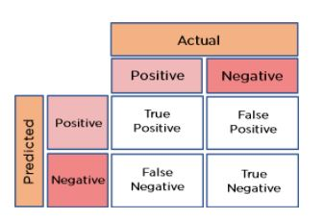
Confusion Matrix
Accuracy
Accuracy tells us about the number of correctly classified points
Precision
Precision tells us about the model's ability to classify positive values correctly i.e. out-of-all the predicted positive values which are correctly predicted positive
simplilearn.com
Sensitivity
Specificity
Sensitivity tells us about the model's ability to predict positive values i.e. out-of-all actual positive values how many are correctly predicted positive
Sensitivity tells us about the model's ability to predict negative values i.e. out-of-all actual negative values how many are correctly predicted negative

Slide 5
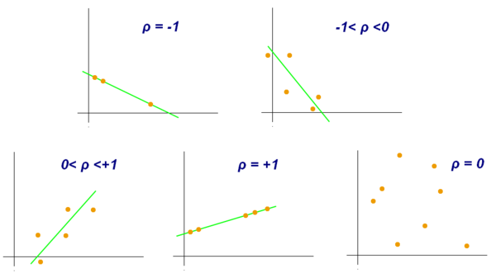
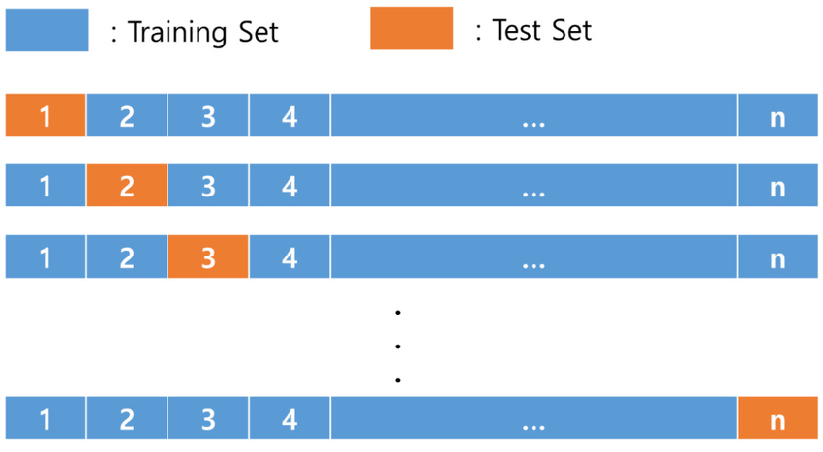
Pearson Correlation
Leave One Out Cross Validation (LOOCV)
wikipedia.org
researchgate.net

Slide 6
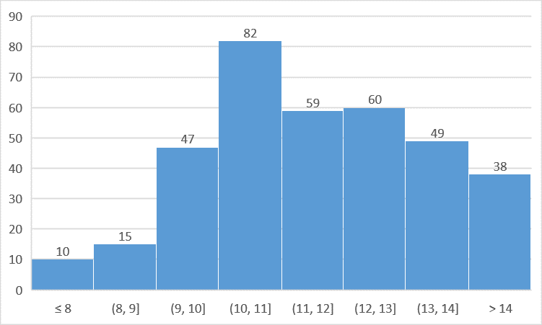
Hemoglobin Distribution
Note: There are a total 360 data points (out of the original 426)
Out of these 66, 8 patients didn’t have venous blood draw Hb value, and around 22 patients’ images was not correct in the images folder. The remaining patients were excluded due to an error while feature extraction

Slide 7





Feature List
Link to Paper
Color Based Features
From RGB Color Space
From HSV Color Space
HHR: high hue ratio (HHR)represents the proportion of pixels with high values in the hue component of the image
From Grayscale Image
Ent: Entropy is used for different textures and blood-vessel distributions
B: Average brightness given by the average grayscale of the image
G features: “g” features are used to observe the blood vessels
mean_r | mean_g | mean_b | mean_rg
Demographic Based Features
Age
Gender

Slide 8
List of Regression Models Compared
SetUp
Linear Regression
SVM Regression
RandomForest
Gradient Boost
k-nearest neighbors (KNN)
Light gradient boosting
CatBoost
Kernel Ridge Regressor
Elastic Net
Bayesian Ridge
XGBoost
The mentioned 11 models are ran on the dataset containing 360 data points and 14 features
These models are ran individually on eye, palm, nail and tongue data AND also on a combination of the above anatomical features
To understand the effect of correlation the models are run on a subset of features with correlation values less than 0.9, 0.8 and 0.7
Finally the dataset is split in 70/30 for training and testing, AND this split is performed 50 times to get the average results

Slide 9
Eye Results
 | Correlation | Model | MAE | R2 | Accuracy | Precision | Sensitivity | Specificity
LOOCV | 0.9 | SVM | 1.188 | 0.319 | 0.836 | 0.624 | 1.000 | 0.775
Sensitivity (avg) | 0.9 | LGBM | 1.293 (0.081) | 0.205 (0.086) | 0.703 (0.049) | 0.440 (0.124) | 0.303 (0.099) | 0.852 (0.057)
Accuracy (avg) | 0.9 | Bayesian Ridge | 1.240 0.090 | 0.270 (0.086) | 0.729 (0.042) | 0.520 (0.191) | 0.233 (0.131) | 0.913 (0.060)
MAE (avg) | 0.9 | Bayesian Ridge | 1.206 (0.082) | 0.309 (0.068) | 0.725 (0.037) | 0.491 (0.264) | 0.169 (0.124) | 0.937 (0.057)
Sensitivity (overall) | 0.9 | Bayesian Ridge | 1.276 | 0.327 | 0.787 | 0.586 | 0.607 | 0.85
MAE (overall) | 0.9 | Bayesian Ridge | 0.996 | 0.474 | 0.815 | 0.643 | 0.375 | 0.940
Acceptable MAE cutoff is 0.5 g/dl
Threshold for Sensitivity is 10.5 g/dL

Slide 10
Nail Results
 | Correlation | Model | MAE | R2 | Accuracy | Precision | Sensitivity | Specificity
LOOCV | 0.9 | Bayesian Ridge | 1.221 | 0.282 | 0.844 | 0.636 | 1.000 | 0.786
Sensitivity (avg) | 0.8 | KNN | 1.281 (0.089) | 0.205 (0.081) | 0.674 (0.039) | 0.366 (0.104) | 0.281 (0.090) | 0.820 (0.047)
Accuracy (avg) | 0.8 | SVM | 1.251 (0.086) | 0.258 (0.068) | 0.733 (0.041) | 0.518 (0.184) | 0.163 (0.081) | 0.941 (0.040)
MAE (avg) | 0.9 | Bayesian Ridge | 1.215 (0.078) | 0.272 (0.070) | 0.725 (0.039) | 0.511 (0.183) | 0.218 (0.106) | 0.915 (0.056)
Sensitivity (overall) | 0.9 | LGBM | 1.155 | 0.253 | 0.796 | 0.586 | 0.630 | 0.852
MAE (overall) | 0.8 | Bayesian Ridge | 0.932 | 0.392 | 0.796 | 0.400 | 0.095 | 0.966
Acceptable MAE cutoff is 0.5 g/dl
Threshold for Sensitivity is 10.5 g/dL

Slide 11
Palm Results
 | Correlation | Model | MAE | R2 | Accuracy | Precision | Sensitivity | Specificity
LOOCV | 0.7 | Linear Regression | 1.159 | 0.334 | 0.858 | 0.658 | 1.000 | 0.805
Sensitivity (avg) | 0.9 | Random Forest | 1.278 (0.076) | 0.219 (0.074) | 0.671 (0.045) | 0.398 (0.131) | 0.326 (0.161) | 0.804 (0.104)
Accuracy (avg) | 0.7 | Bayesian Ridge | 1.266 (0.099) | 0.218 (0.109) | 0.721 (0.047) | 0.482 (0.262) | 0.199 (0.200) | 0.915 (0.103)
MAE (avg) | 0.9 | Bayesian Ridge | 1.255 (0.116) | 0.228 (0.123) | 0.718 (0.047) | 0.538 (0.263) | 0.202 (0.210) | 0.912 (0.112)
Sensitivity (overall) | 0.9 | Gradient Boost | 1.351 | 0.164 | 0.657 | 0.451 | 0.719 | 0.632
MAE (overall) | 0.7 | Linear Regression | 1.059 | 0.266 | 0.796 | 0.556 | 0.417 | 0.905
Acceptable MAE cutoff is 0.5 g/dl
Threshold for Sensitivity is 10.5 g/dL

Slide 12
Tongue Results
 | Correlation | Model | MAE | R2 | Accuracy | Precision | Sensitivity | Specificity
LOOCV | 0.8 | SVM | 1.201 | 0.302 | 0.850 | 0.645 | 1.000 | 0.794
Sensitivity (avg) | 0.8 | Linear Regression | 1.264 (0.101) | 0.251 (0.100) | 0.695 (0.040) | 0.452 (0.091) | 0.336 (0.163) | 0.835 (0.095)
Accuracy (avg) | 0.8 | Bayesian Ridge | 1.225 (0.077) | 0.278 (0.062) | 0.727 (0.039) | 0.500 (0.117) | 0.257 (0.108) | 0.903 (0.045)
MAE (avg) | 0.8 | Bayesian Ridge | 1.225 (0.077) | 0.278 (0.062) | 0.727 (0.039) | 0.500 (0.117) | 0.257 (0.108) | 0.903 (0.045)
Sensitivity (overall) | 0.8 | Linear Regression | 1.285 | 0.226 | 0.704 | 0.512 | 0.667 | 0.720
MAE (overall) | 1.0 | Random Forest | 1.038 | 0.378 | 0.713 | 0.367 | 0.478 | 0.776
Acceptable MAE cutoff is 0.5 g/dl
Threshold for Sensitivity is 10.5 g/dL

Slide 13
Moving Forward
Replicate other paper which have better results on our dataset
Feature Importance for all anatomies followed by regression

